Slide 1
Simple Summary

Slide 2
Linux OS
版本：
Fedora
Ubuntu & Debian(e.g. Ubuntu 16.04 LTS )
RHEL & CentOS
安装：
双系统
虚拟机

Slide 3
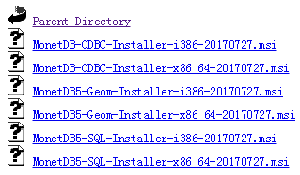
MonetDB Installation
Linux
wget --output-document=- https://www.monetdb.org/downloads/MonetDB-GPG-KEY | sudo apt-key add –
sudo apt update
sudo apt install monetdb5-sql monetdb-client
Windows

Slide 4
MonetDB Architecture
monetdbd
dbfarm
db1
db2
db3
port

Slide 5
MonetDB Commands
Type | Name | Description
Server program | monetdbd | The MonetDB Database Server daemon.
 | mserver5 | The MonetDB server, version 5. It runs as a console program. Client programs (except monetdb) connect to this server process.
Client program | monetdb | A command-line program to control the monetdbd deamon server by executing a single command. It allows you for instance to start & stop an mserver5 process or create a new database.
 | mclient | A command-line program to interactively communicate to a running mserver5 process. The program is intended for technical persons, e.g. DBA's, SQL developers and system adminstrators.
 | msqldump | A command-line program to export the structure and content of a database or a specific table to a file.

Slide 6
MonetDB Login
shell> monetdbd create ~/dbfarmname
shell> monetdbd start ~/dbfarmname
shell> monetdb create dbname
shell> monetdb release dbname
shell> monetdb start dbname
shell> mclient -u monetdb -d dbname

Slide 7
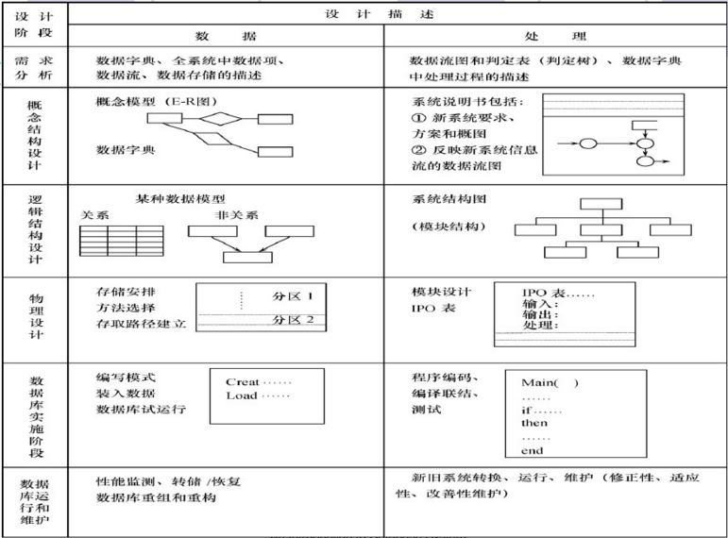
Database Design

Slide 8
Data Management
SQL
SQL功能 | 动词
数据查询 | SELECT
数据定义 | CREATE,DROP,ALTER
数据操纵 | INSERT,UPDATE,DELETE
数据控制 | GRANT,REVOKE

Slide 9
Data Import
1.获取数据
2.确定导入格式
3.格式化
4.批量导入

Slide 10
API
GUI API
JDBC
ODBC
Language bindings
Python
R
JavaScript/Node.js
Ruby/Rails
Perl DBI
PHP5

Slide 11
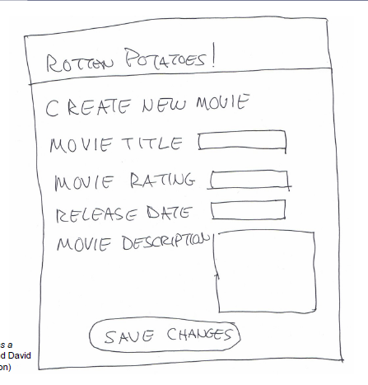

GUI
Behavior-Driven Design

Slide 12
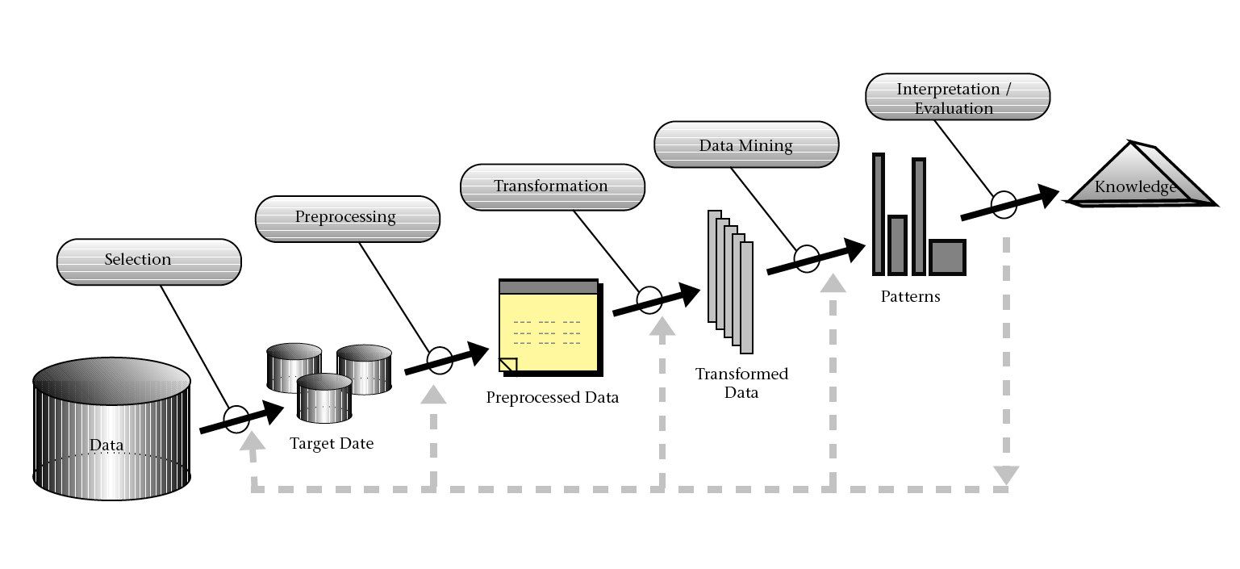
Data Mining

Slide 13
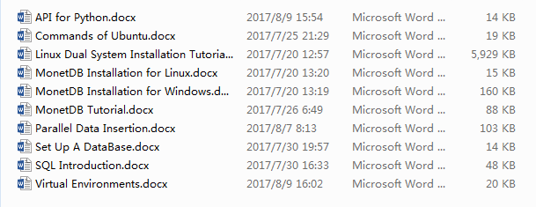
Files

Slide 14
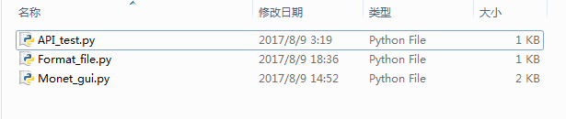
Files

Slide 15
Thanks!

